Slide 1
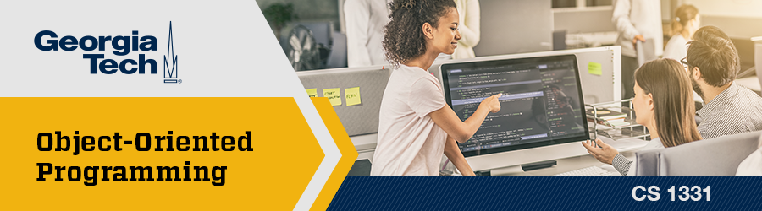
Recitation 2 /////

Slide 2
Announcements
Programming Exercise 0 and First Day Survey due TODAY (08/31)
Programming Exercise 1 due on Monday (09/06)
Programming Exercise 2 will released on Friday (09/03)
If you are still having issues with Java installation, downloading a text editor, accessing the textbook, etc. please talk to us after recitation TODAY or come to Office Hours!!

Slide 3
Office Hours
TA Office Hours are now open!!!
Monday – Friday, for specific TAs’ hours check the Canvas homepage.
Office hours are the perfect resource for reviewing code, going over course concepts, or any time where you want a live discussion with a TA.
Office hours are in person and are located on the 2nd floor of the CoC building in the 1331 designated cubicle.

Slide 4
Pre-Quiz
In Java, can a variable’s type be changed after it is declared? (Y/N)
int num1 = 3/2, double num2 = 3/2. What are the values of num1 and num2?
3. Is the following narrowing or widening? Is it legal?
double to float
int to long
double y = 3/4
4. In Java, can you create a variable without declaring its type beforehand? (Y/N)
Notes:
Coding Demo: Variables

Slide 5
Pre-Quiz
In Java, can a variable’s type be changed after it is declared? (Y/N) No
int num1 = 3/2, double num2 = 3/2. What are the values of num1 and num2? 1 and 1.0
3. Is the following narrowing or widening? Is it legal?
double to float (narrowing, illegal)
int to long (widening, legal)
double y = 3/4 (widening, legal)
4. In Java, can you create a variable without declaring its type beforehand? (Y/N) No
Notes:
Coding Demo: Variables

Slide 6
Topics for Today
Variables (assignment, naming practice)
Primitives
Literals/Constants
Expressions (operators & precedence) & Type Conversion
Commenting
Debugging
Notes:
Coding Demo: Variables

Slide 7
Variables
A place in memory where a value is stored
Declaration:
int myInt;
<type> <variable name>;
Assignment:
myInt = 32;
<variable name> = <value>;
This can be done in the same line as int myInt = 32;
Initializing: First time assigning a value to a variable
Notes:
Coding Demo: Variables

Slide 8
Naming
Be descriptive
z = x / y; is hard to read versus average = sum / numElements;
Java uses the camelCase convention (this is different than syntax)
Name cannot use reserved words
public, static, class, int, double, float, etc.
Name cannot start with a number.

Slide 9
Variable Naming Practice
Is it a good name or bad name for a variable?
1. this
2. x
3. Panda
4. classAverage
5. 1stRound
(NO, can’t use reserved word)
(NO, not descriptive)
(NO, not camel case)
(Yes!)
(NO, can’t start with a number)

Slide 10
Variable Type
2 Categories for the type of a variable
Primitive
Object/Reference Types (this is coming up in lecture)

Slide 11
Primitives
Variables that are a primitive type hold the value itself.
Variable types are all lower case! (boolean NOT Boolean)
8 types of primitives provided by Java:
Integer numbers: byte, short, int, long
Floating Point numbers: float, double
Other: char, boolean

Slide 12
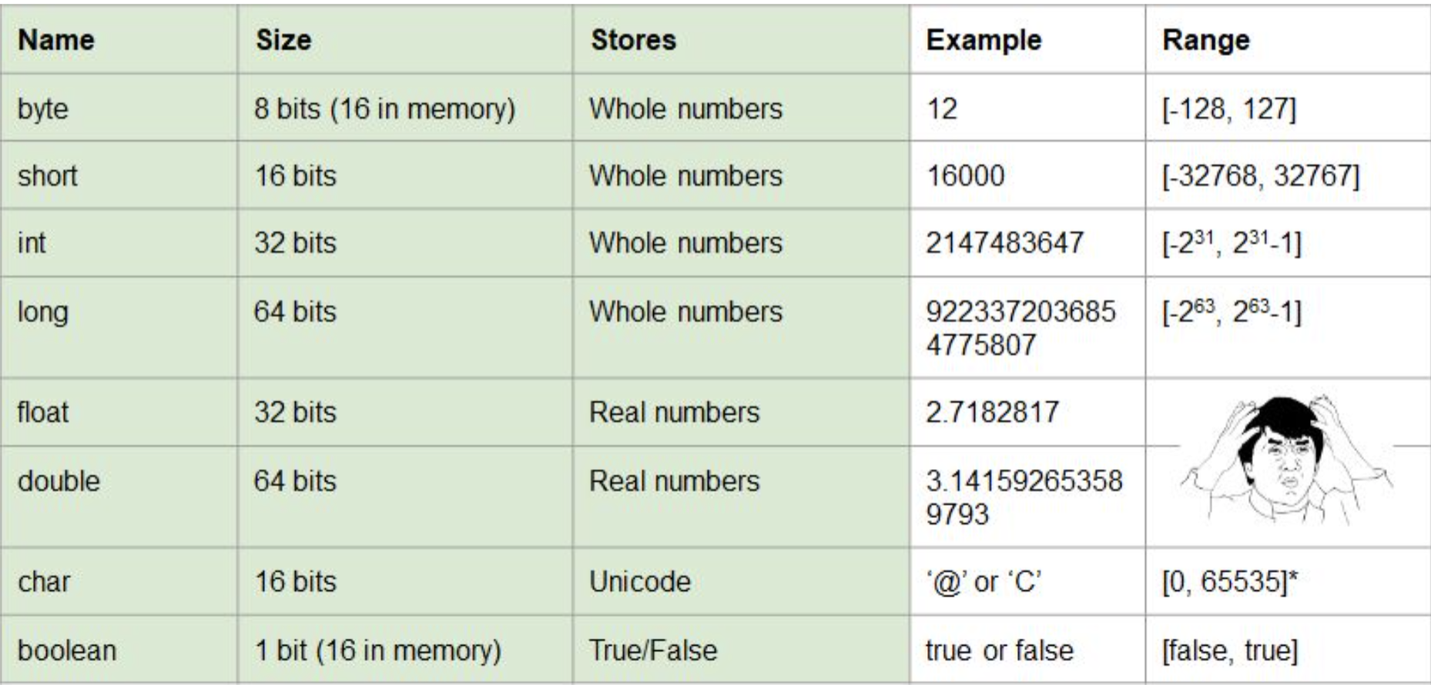
Primitives

Slide 13
Literals
Any constant value that can be assigned to a variable: 12.0, 45, 7
Examples are: numeric (integer/floating point), boolean, char, String, and enum
int myInt = 100;
boolean bool = true;
String s = "Hello";
We will be coming back to enums later

Slide 14
Constants
Any variable whose value cannot change once it has been assigned
Add the keyword "final" in front of the variable declaration
final int MY_INT = 3;
Naming convention is ALL CAPS and snake_case
Notes:
Coding Demo: DataTypes

Slide 15
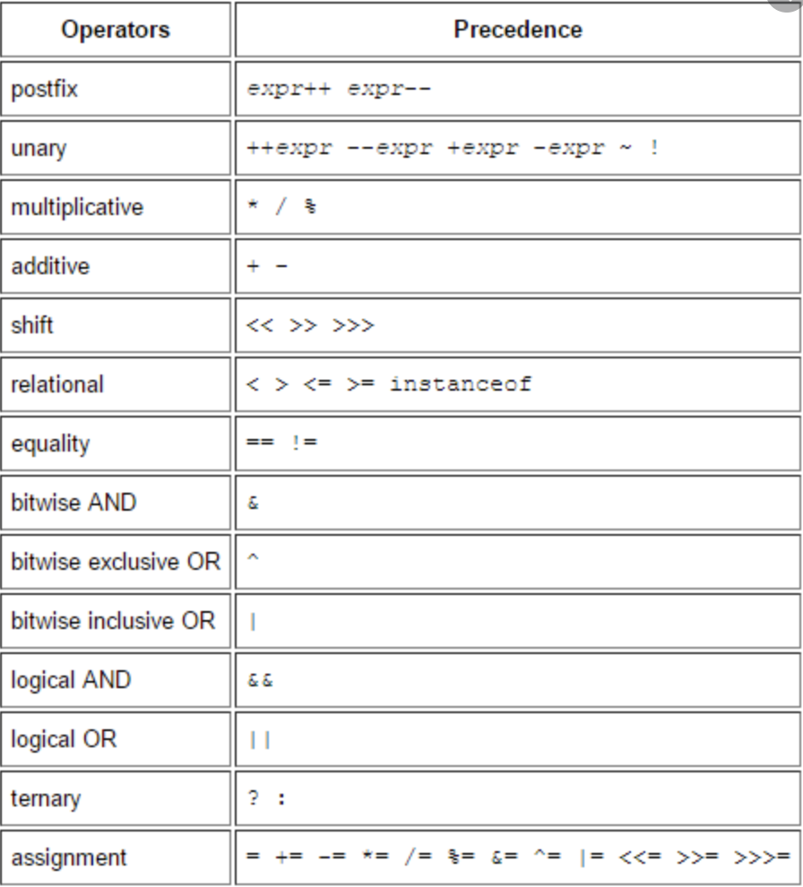
Operators

Slide 16
Type conversion
Narrowing: Bigger goes to smaller (loses precision)
double -> int
Not allowed in Java
Widening: Smaller goes to bigger (doesn’t lose precision)
byte -> int
Allowed in Java

Slide 17
Explicit vs Implicit Casting
What’s the difference?
Explicit casting must be done when there could be a loss of data. Otherwise, it will be a compilation error. We will come back to this later in the semester.
Remember, this does not change the original variable type.
It just temporarily changes the way the value of the variable is treated for a specific expression.
Implicit casting is done automatically (see next slide)

Slide 18
Type Conversion (continued)
In Java, there are three main ways to convert between primitives
Assignment (implicit casting)
double sum = 5; //adds .0 to end
Arithmetic promotion (implicit casting)
double quotient = 5.0 / 2;
double x = 2 + 2.0;
Casting explicitly (explicit casting)
int badNum = (int) 3.14; //truncates

Slide 19
Commenting
Single line comments
//Comments here (Text in this line only is considered as a comment and not actually executed as code)
Multiline comments
/* Comment starts
* continues
* continues . . .
* Comment ends */

Slide 20
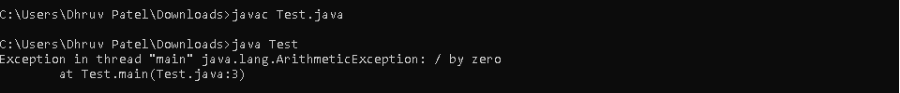
Debugging
Use print statements to find which part of your code is executing and which part is not!
The compiler gives you a TON of info so make sure you pay attention to the type of error you are getting as well as the file name and line number! This will make finding the problem that much faster! Take a look at the example below and see if you can find the file name and line number associated with this issue as well as what is going wrong.

Slide 21
Live Coding
TA's will now go through two live coding activities!!!
The first one covers different type conversion (DataTypes.java)
The second one covers debugging examples (Debugging.java)

